Slide 1
Hair and Fiber
Hair and Fiber were, for a long time, examined with a microscope
Now with new Technology:
Hair examined through DNA’
  Fiber examined through electronic
  instruments.

Slide 2
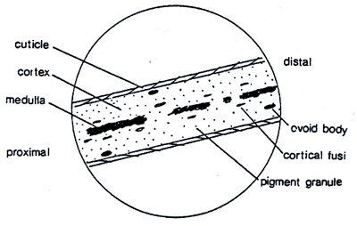
Nature of Hair Evidence
Mitochondrial DNA (deoxyribonucleic acid)
  Hair shaft
  DNA present in the shaft of the hair in cells outside the nucleus.

Slide 3
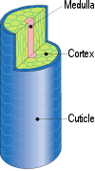
Nature of Hair Evidence
Hair is outgrowth of epidermis consisting of dead cellular materials.
Hair has three layer:
  Cuticle – Outer layer
  Cortex – Middle layer
  Medulla – Inner layer

Slide 4
Nature of Hair Evidence
Each hair grows from a hair follicle in the skin in three phases.
Anagen – actively produces hair
Catagen – transitional phase
Telogen – hair stops growing and “rests” until it falls out

Slide 5
Nature of Hair Evidence
Cross section of hair:
  Can be flat, ribbon shaped, round, triangular.
Straight hair = round cross section
Wavy hair = oval cross section
Curly hair = flattened cross section

Slide 6
Nature of Hair Evidence
Cross-section and waviness somewhat related to racial characteristics:
  Asian, Native American & Hispanic = straight hair w/round cross sections.
  Europeans range from straight to very curly and overlap w/ two other major racial groups

Slide 7
Nature of Hair Evidence
Caucasians = long, straight black scalp
hair indistinguishable to that of Asians.
  Others have tight curly black hair similar to that of the African hair type.
  Pubic hair from all racial groups are flattened in cross section.

Slide 8
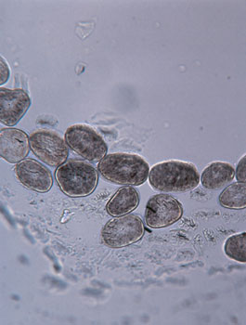
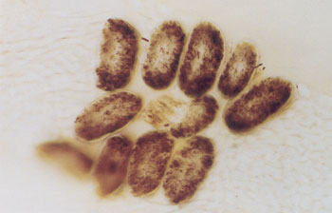
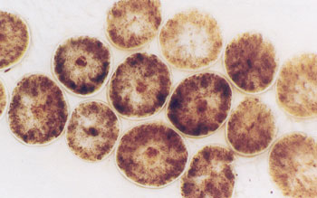
Nature of Hair Evidence
Cross Sections:

Slide 9
Nature of Hair Evidence
  African groups = curliest pubic hair
  Asian groups = least curliest pubic hair, slightly curled and wavy.
  European groups = intermediate between Asian and African racial groups w/curliness ranging between tightly curled to loosely curled

Slide 10
Significant Features of Hair
Most significant to Investigator and Lab Analyst:
Hair color due to two hair pigments.
  Melanin (brown)
  Tricosiderin (red)

Slide 11
Significant Features of Hair
Black hair = deep brown
Blond hair = light brown
Red-Brown = combined red and brown
  Range from Auburn to Strawberry Blond
  Under microscope very distinguishable to lab examiner
White hair has no pigments in the shaft.

Slide 12
Significant Features of Hair
Other significant feature to Investigator and Lab Analyst:
Length and degree of curl
Length can be suggestive of gender.

Slide 13
Microscopic Features of Hair
Under microscope one can see:
  Pigment granules
  Medulla
  Cortical fusi (small air sacs)
  Cuticle scales
  Root characteristics
  Hair damage
  Diameter of the shaft

Slide 14
Microscopic Features of Hair
Cuticle:
  Consists of a number of scales surrounding the hair shaft.
  Overlap similar to roofing shingles
  Only edges are visible under microscope unless hair has been damaged

Slide 15
Microscopic Features of Hair
Scale pattern:
  Animal hair scales differ from Human hair scales
  Exposed tip of scales point toward tip of hair
  Helps orient the distal or proximal direction of hair absent the root.

Slide 16
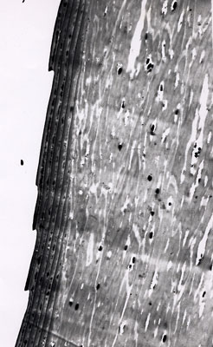
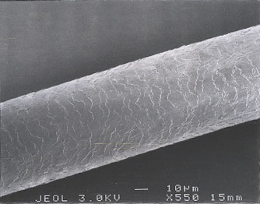
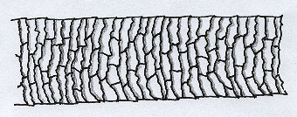
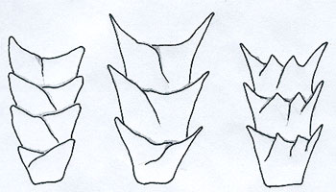
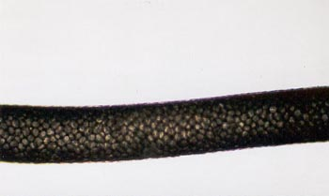
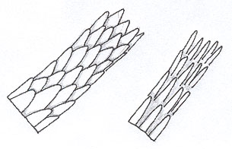
Microscopic Features of Hair
Cuticles:

Slide 17
Microscopic Features
Cortex:
  Consists of elongated fibers composed of keratinized filaments.
  Keratinized proteins make hair strong.
  Contains most features used to analyze hair:
    Pigment granules, cortical fusi, ovid bodies, & other microscopic features

Slide 18
Microscopic Features
Pigment granules contain the melanin:
  Melanin gives the hair its shades of brown color.
  Cortical fusi – small sacs of air (spherical to ovoid in shape.
  Ovid bodies have light brown color.

Slide 19
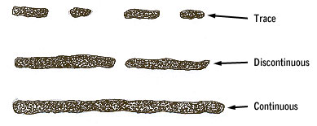
Microscopic Features
Medulla:
  Appears either dark or opaque under microscope
  If filled of liquid may appear light brown or translucent
  Can appear as absent, continuous or intermittent.

Slide 20
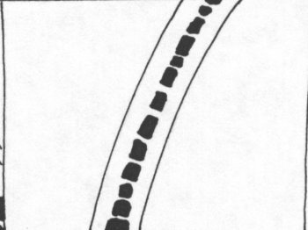
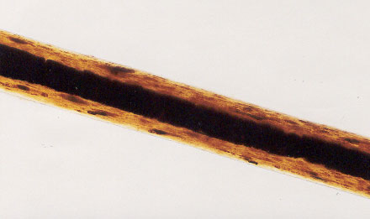
Microscopic Features
Medulla:
  Considered Amorphous: without form
  Animal hair – has well defined Medulla

Slide 21
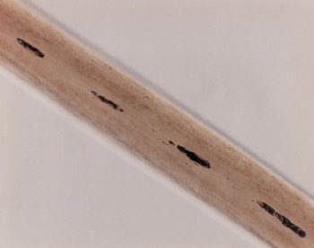
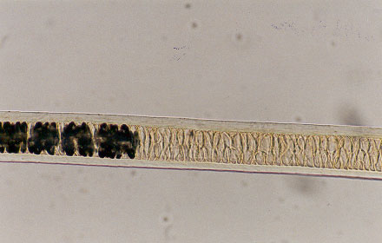
Microscopic Features
Medulla:
Human Medulla – less than 1/3 hair shaft
Animal Medulla - > ½ hair shaft

Slide 22
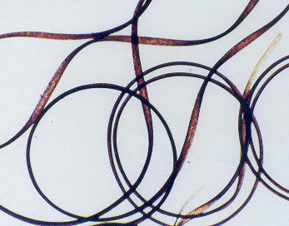
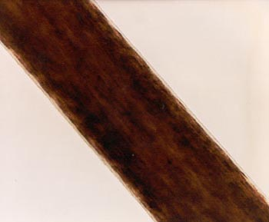
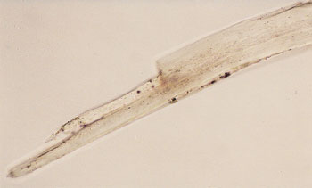
Other Characteristics in Hair
For Forensic Comparison:
  Degree of curl
  Maximum diameter of the hair shaft
  Characteristics of hair tip

Slide 23
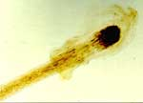
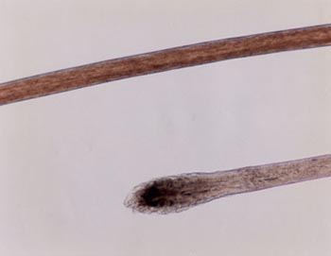
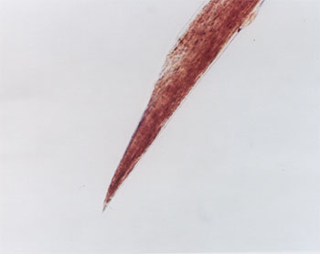
Other Characteristics of Hair
Characteristics of hair tip:

Slide 24
Other Characteristics in Hair
Treatment of Hair:
  Bleaches and dyes
  If hair root is attached, can estimate time since bleaching and dying occurred.
  Cuticle may be damaged by cosmetics giving forensic comparison

Slide 25
Other Characteristics in Hair
Color or hair:
  Hair color is a result of both optical properties and the size, density, and distribution of the hair pigment granules (melanin) and the degree of red pigment present in the hair.

Slide 26
Collection of Hair Evidence
Hair evidence can be collected by:
  Collecting object the hair is attached to
  Performing a tape lift
  Combing or brushing (pubic area)
  Vacuuming area suspected of containing hairs
  Plucking hair from designated areas of body

Slide 27
Precautions for Evidence Hairs
Package individual hairs in an individual container.
Do not package wet evidence.
Place exhibits only on a clean table surface. Eliminates cross-contamination.
Label each evidence container w/standard identification data.

Slide 28
Standard/Control Specimens of Hair
Preferred method of hair collection:
  A. Pulled hair – Can examine growth phase
  B. Backcombed hairs
  C. Cut (near the skin)
  Use new plastic comb on only one subject and package with hair evidence.

Slide 29
Standard/Control Specimens of Hair
Pubic Hair Standards:
  Collect about fifty hairs total (top left, top right, top center, middle left and middle right)
  Preferred to collect pulled hair – cut hair acceptable in some cases. Cut as close to skin as possible.

Slide 30
Laboratory Examinations of Hair Evidence
Two main purposes:
  a. Microscopic examination
  b. Genetic marker analysis (DNA of follicle
or shaft)

Slide 31
Possible Laboratory Results
Whether the hair is animal or human
  The body type of hair (scalp, pubic, beard)
  Investigative leads:
    Hair color, length, “racial” characteristics, etc.
  Whether the hair matches a suspect
  If the hair does not match a suspect
  That the hair comparison is inconclusive
  nDNA matches a suspected source
  ntDNA matches a suspected source

Slide 32
Fiber Evidence
Common method of classifying fibers:
A. Natural fibers
  1. Vegetable fibers
  2. Animal fibers
  3. Mineral Fibers

Slide 33
Fiber Evidence
Vegetable Fibers:
  Cotton
  Linen
  Flax
  Hemp
  Jute
  Sisal

Slide 34
Fiber Evidence
Animal Fibers:
  Sheep Wool
  Alpaca
  Angora
  Camel
  Silk

Slide 35
Fiber Evidence
Mineral Fibers
  Asbestos

Slide 36
Fiber Evidence
B. Synthetic Fibers
  Acetates, Triacetates Acrylics Nylons
  Armids (Kevlar) Teflon Glass fibers
  Modacrylics (Dynel) Rayons Metallic
  Olefins (Polyethylene) Spandex
  Polyesters (Dacron) Vinyons

Slide 37
Occurrence of Fiber Evidence
Fibers become evidence through a transfer – linkage – associative – or contact with two objects.
Locard Exchange Principle:
  Contact between individuals results in an exchange of materials between the two individuals.

Slide 38
Laboratory Examinations
Lab exams involve a comparison between the fiber in question and the fiber submitted as a standard (known fiber).
  Involves:
    Fiber type
    Color
    Microscopic appearance
    Cross-sectional shape
    Composition of the dye present

Slide 39
Laboratory Examinations of Fibers
Examinations include:
  Low-power microscopy with stereoscopic microscopy
  High-power microscopic examination
  Examination by polarized microscopy
  Comparison microscopy
  Dyes in the fibers are examined by chemical analyses & w/modern spectroscopic methods

Slide 40
Securing Fiber Evidence
In order to secure fiber evidence for transportation to the laboratory the evidence must be placed into a Pharmacy Fold.
Demonstrated in class.

